Slide 1
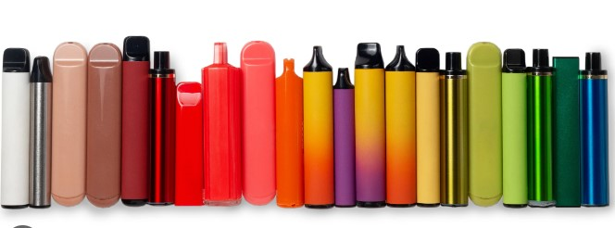
The Waste Electrical and Electronic Equipment Regulations for Single Use Vape Retailers.
Miss Bubbly Sandhu
OPSS Senior Regulatory Officer for WEEE, & Battery Takeback
0121 345 1226

Slide 2
OPSS enforce the WEEE Regulations on behalf of Defra
WEEE Regulations, 2013, Part 5 Takeback
All businesses that sell/retail Single use vapes MUST have in place a process of takeback, in accordance with the above Regulations.
You are classed as a “Distributor” if you retail /sell single use vapes.
As a distributor you have obligations to ensure that waste vapes are recycled for free.
You must display to customers how you provide takeback under the WEEE regulations.
If you fail to comply, you can be prosecuted and receive an unlimited fine in court.
You have 2 options you must select.

Slide 3
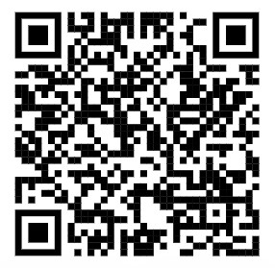
WEEE Regulations, 2013, Part 5 - Takeback
Option 1 – Join Distributor Takeback Scheme
If as a retailer your sales revenue is below 100k per year, OR you sell online only. You can join the Distributor Takeback Scheme (DTS), where your membership will contribute to recycling amenities and initiatives. Scan the QR code to take you to the website;

Slide 4
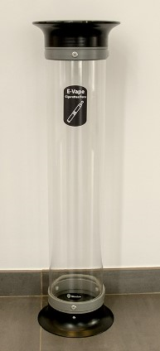
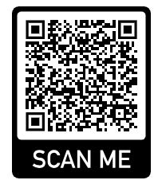
WEEE Regulations, 2013, Part 5 - Takeback
Option 2 – Waste Vape Bin
As a vape retailer you must ensure you have a waste vape bin from where you sell single use vapes. A waste vape bin can be obtained from a WEEE Compliance Scheme or an AATF, as list is available from the below QR code:
Place the bin in-store, so customers can discard their waste vapes.
Once the waste vape bin is full, contact a WEEE Compliance Scheme or a AATF to collect the bin.
Maintain a record of collection for up to 4 years.

Slide 5
Information to customers
Retailer toolkit – created with Material Focus
Editable for your own branding
Must provide information to consumers regarding takeback
Do not discard in household waste.
Retailers MUST retain records for up to 4 years.
For more information you can visit: OPSS WEEE Regulations

Slide 6
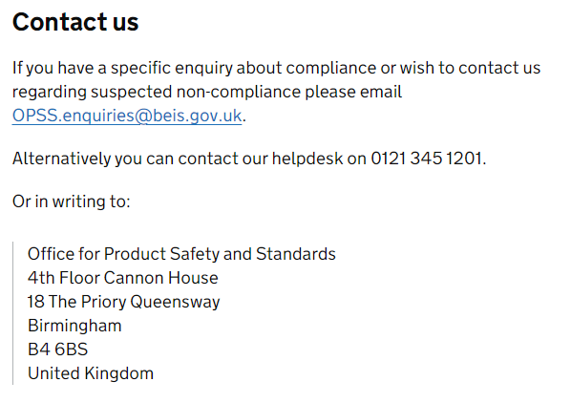
OPSS CONTACT

